Slide 1

FrontTech DX Angular
Abril 2021

Slide 2
Index
Angular introduction
Getting started
Modules
Components. The basics
Directives
Models
Pipes
Components. Communication between components
Services
Forms
Observables
Routing and navigation
HTTP Requests
Debugging
Introduction to testing practices

Slide 3
Index
Angular introduction
Getting started
Modules
Components. The basics
Directives
Models
Pipes
Components. Communication between components
Services
Forms
Observables
Routing and navigation
HTTP Requests
Debugging
Introduction to testing practices

Slide 4
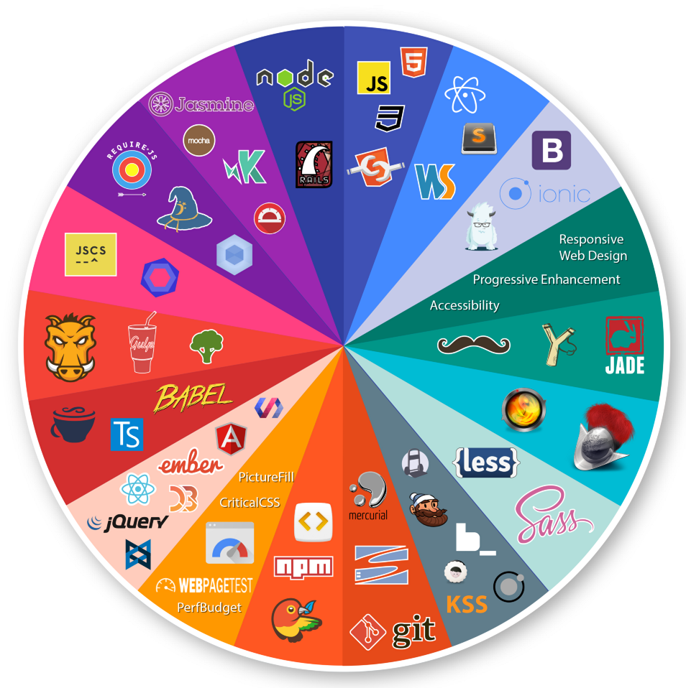
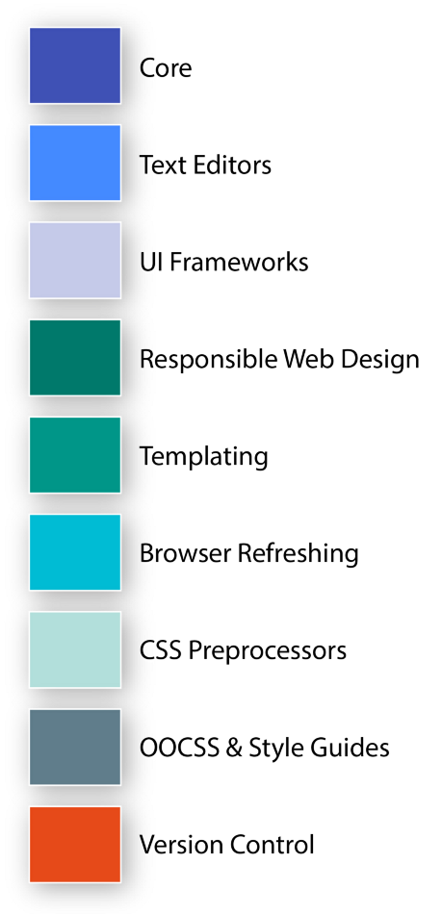
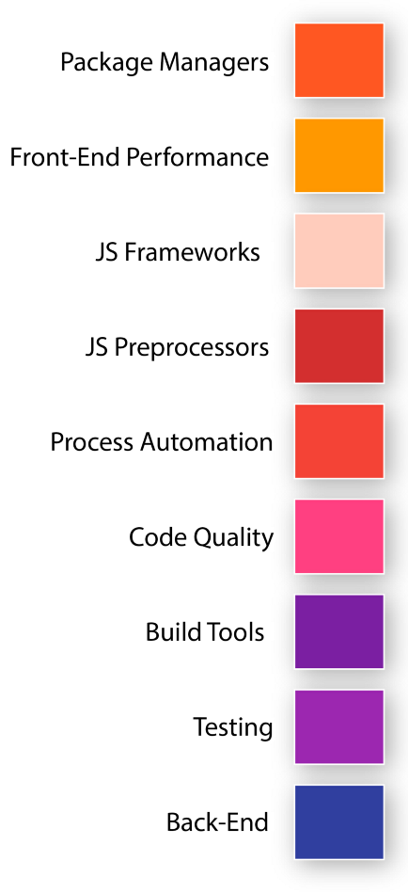

1. Angular introduction
Front End Technologies Show Case

Slide 5
1. Angular introduction
Angular's insights
JavaScript Framework which allows you to create reactive Single-Page-Applications (SPAs).
Enhances the user experience with fast enriched interactions, similar to Desktop and Mobile apps.
JS changes currently loaded page (index.html) by updating sections and modifying the DOM.
Community, popularity and maintainability.
Written in TypeScript, which syntax adds consistency to the information and the way the code is read by adding static types and classes based objects.
Examples of apps made with Angular.

Slide 6
1. Angular introduction
ECMAScript
ECMAScript is a standard which determines how to use the JavaScript language.
June 1997
ECMAScript 1
June 1998
ECMAScript 2
December1999
ECMAScript 3
December 2009
ECMAScript 5
ES5
June 2015
ECMAScript 6
ES6/2015
June 2016
ECMAScript 7
ES7/2016
June 2017
ECMAScript 8
June 2018
ECMAScript 9
June 2019
ECMAScript 10
TypeScript
ES 7
ES 5
ES 6

Slide 7
1. Angular introduction
Angular versioning
Angular 10
Angular 1
Angular 9
Complete Re-Write
…
Angular 2
Just “Angular”
“AngularJS”
Incremental improvements. No complete Re-Writes!
Not really related to Angular 2+
How to upgrade the version from an Angular app
Notes:
update.angular.io

Slide 8
Index
Angular introduction
Getting started
Modules
Components. The basics
Directives
Interfaces and models
Pipes
Components. Communication between components
Services
Forms
Observables
Routing and navigation
HTTP Requests
Debugging
Introduction to testing practices

Slide 9


2. Getting started
Node.js and npm
Node.js is a JavaScript runtime built on Chrome's V8 JavaScript engine.
NPM is a package manager for Node.js packages.
The NPM Registry is a public collection of packages of open-source code for Node.js, front-end web apps, mobile apps, robots, routers, and countless other needs of the JavaScript community.
NPM, and its CLI, are installed on your computer when you install Node.js.

Slide 10

2. Getting started
Source code editor: Visual Studio Code
IntelliSense
Command palette and shortcuts
Integrated version control (built-in Git)
Debugging
Some code management features
Terminal integrated
Extensions (Best Visual Studio Code extensions)
Native support for a great variety of languages
Customizable UI
Angular Essentials plugin
Notes:
An integrated development environment (IDE) is a software application that provides comprehensive facilities to computer programmers for software development. An IDE normally consists of at least a source code editor, build automation tools, and a debugger.

Slide 11
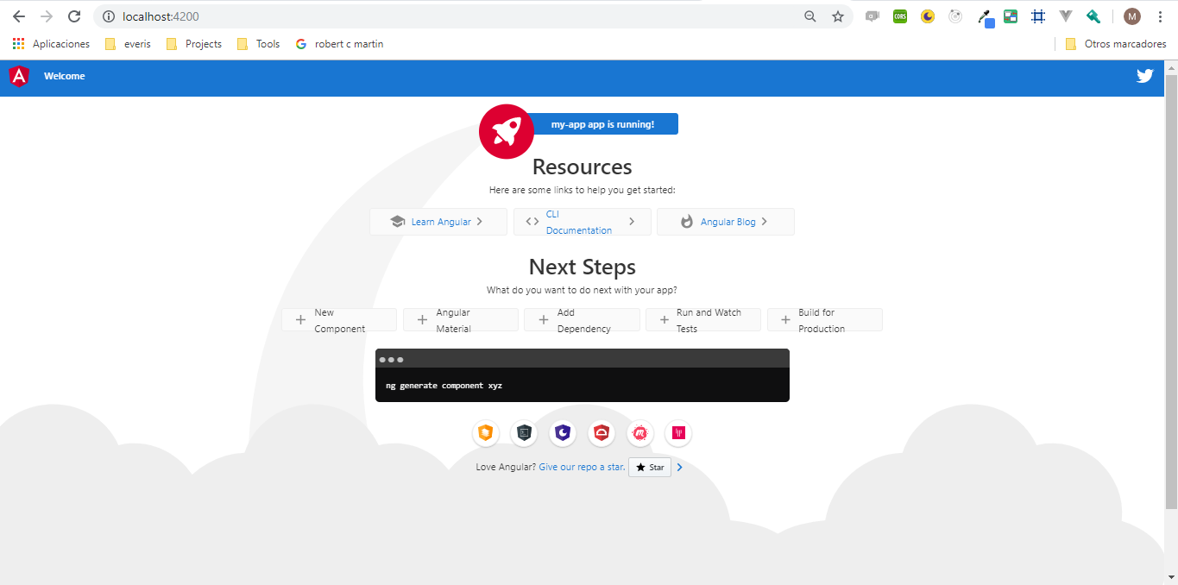
2. Getting started
Angular CLI, create and run an Angular app
Install Angular Command Line Interface:
$ npm install -g @angular/cli
Create a new project folder and run:
$ ng new my-app
Run the application:
$ cd my-app
$ ng serve
Open http://localhost:4200/ on browser.
Angular CLI Cheat Sheet
Notes:
This tool allows to create, manages, builds and test Angular projects locally while developing. It makes it easy to create an application, generate components, routes, services and pipes with a simple command through a terminal window in the code editor. It automatically creates the set of needed files with a default structure and sets up the app module declaring there is a new element on the application, making the development of them become more effective.

Slide 12
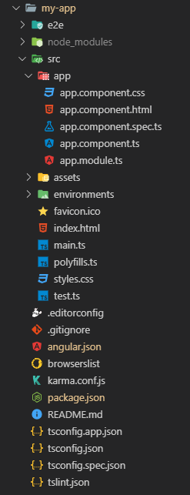
2. Getting started
The project folder
e2e: contains end-to-end testing files for the project
node_modules: contains libraries downloaded from npm.
src: this is the main application source folder, where we will be working most of the time
other files to take into account:
package.json
angular.json
tslint.json
tsconfig.json
Notes:
Workspace configuration files: https://angular.io/guide/file-structure
package.json: Configures npm package dependencies that are available to all projects in the workspace.
angular.json: CLI configuration defaults for all projects in the workspace, including configuration options for build, serve, and test tools that the CLI uses.
tslint.json: Default TSLint* configuration for projects in the workspace.
tsconfig.json: Default TypeScript configuration for projects in the workspace.
*TSLint is an extensible static analysis tool that checks TypeScript code for readability, maintainability, and functionality errors. It is widely supported across modern editors & build systems and can be customized with your own lint rules, configurations, and formatters.

Slide 13
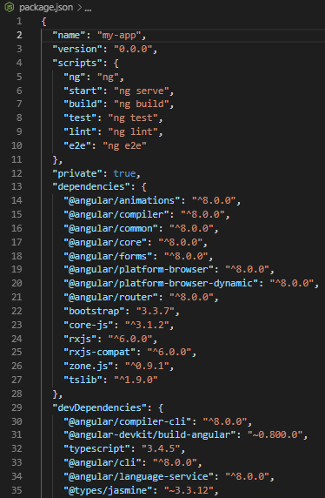
2. Getting started
The package.json file
scripts are the commands we can execute in the project by associating them a key for npm recognizes them:
start: launch the server and compile the app.
test: execute the tests.
build: save the compiled app (the set of bundles) in a new dist folder.
dependencies are the dependencies we need to execute the application.
devDependencies are the dependencies we need just to develop.
Notes:
npm scripts: https://docs.npmjs.com/misc/scripts
package.json info (spanish) https://medium.com/noders/t%C3%BA-yo-y-package-json-9553929fb2e3
The package.json defines what libraries will be installed into node_modules when you run npm install. It is useful to avoid upload the node_modules folder in a repository. We can get all the dependencies defined in the package.json by running the command: npm install

Slide 14
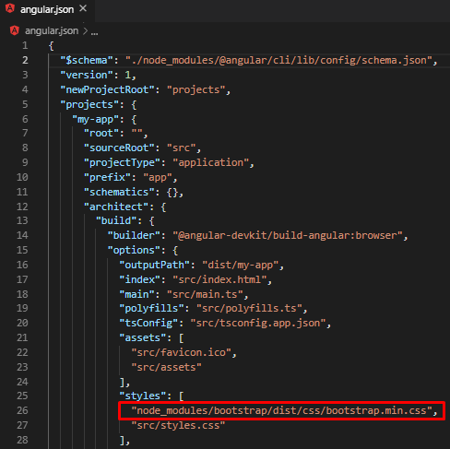
2. Getting started
Bootstrap
Bootstrap is an open source toolkit for developing with HTML, CSS, and JS.
Install Bootstrap:
$ npm install bootstrap --save
Add the bootstrap styles file in angular.json:
“node_modules/bootstrap/dist/css/bootstrap.min.css”
Other UI frameworks:
Angular Material
PrimeNG
Font Awesome
Notes:
Restart the server if it was launched.

Slide 15
Index
Angular introduction
Getting started
Modules
Components. The basics
Directives
Models
Pipes
Components. Communication between components
Services
Forms
Observables
Routing and navigation
HTTP Requests
Debugging
Introduction to testing practices

Slide 16
3. Modules
Introduction to modules
Containers for a cohesive block of code dedicated to an application domain, a workflow, or a closely related set of capabilities.
Can contain components, service providers, and others.
Functionalities of a specific module can be used in other modules.
Defined by a class decorated with @NgModule.
Every Angular app has at least one NgModule class, the root module, conventionally named AppModule.
AppModule (root)
import at root
CoreModule
App-wide components and services
InsurancesModule
import as needed into features
SharedModule
Highly reusable components
feature modules
MortgagesModule
InvestmentsModule
FormsModule
Angular built-in modules

Slide 17
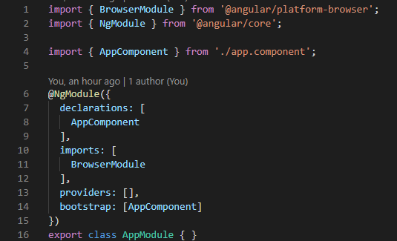
3. Modules
AppModule
The AppModule is the root module of the application.
The application is launched by bootstrapping the root NgModule (in main.ts).
NgModule takes single metadata object, whose properties describe the module:
declarations
imports
exports
providers
bootstrap
…
app.module.ts
Notes:
declarations: components, directives, pipes
imports: other modules (to use some of their functionalities in the module)
exports: expose components/directives/pipes to allow other modules to use them
providers: services, guards
bootstrap: define the first component will be rendered in the browser once the module will be loaded

Slide 18
3. Modules
AppModule workflow
Indicates to the browser it has to bootstrap the AppModule
main.ts
Defines the AppComponent the first component to render when the module is loaded
app.module.ts
Defines its selector (HTML tag) as app-root
app.
component.ts
Adds the app-root element within body tag.
index.html

Slide 19
Index
Angular introduction
Getting started
Modules
Components. The basics
Directives
Models
Pipes
Components. Communication between components
Services
Forms
Observables
Routing and navigation
HTTP Requests
Debugging
Introduction to testing practices

Slide 20
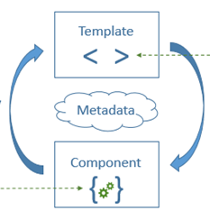
4. Components. The basics
Introduction to components
Components are the fundamental building blocks of Angular apps.
Display data on the screen, listen for user input, and take action based on that input.
A component can be as complex as the programmer decides.
It can be distinguished two main parts of a component:
The business logic, written in TS files.
The template, which defines the view and it is written in HTML files.

Slide 21
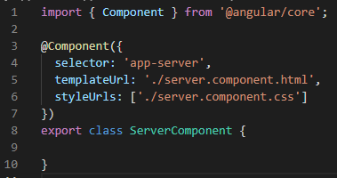
4. Components. The basics
Create a component manually
The component's application logic is defined inside a class.
Decorator @Component marks the class as an Angular component and provides configuration metadata.
Configuration properties (metadata):
selector: tells Angular under which name/tag has to create and insert an instance of this component, it must be unique in the whole app.
template: defines what needs to be rendered in the DOM in HTML.
styles: defines the styles and classes
server.component.ts
Notes:
The metadata defines a set of configuration properties that determines how the component should be processed, instantiated, and used at runtime

Slide 22
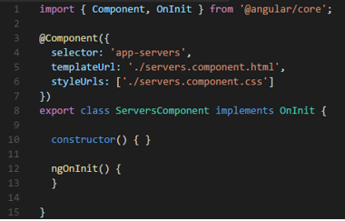
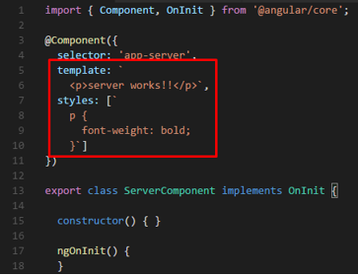
4. Components. The basics
Create a component manually
Different ways to write templates and styles: in separated files or in the TS file
server.component.ts
server.component.ts

Slide 23
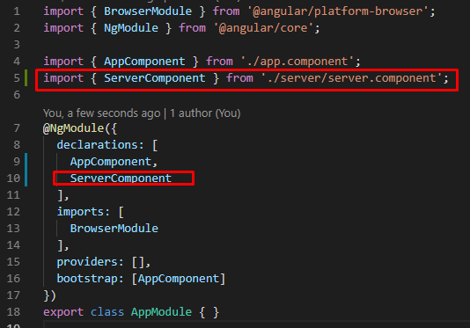
4. Components. The basics
Create a component manually
It is required to declare the new component in the module where it is defined.
app.module.ts

Slide 24
4. Components. The basics
Create a component with CLI
Use the command:
$ ng generate component component_name
TS, HTML and CSS files are created automatically within a new component_name folder.
The new component is declared in the module.
Angular CLI commands

Slide 25
4. Components. The basics
Lifecycle hooks
Angular creates it, renders it, creates and renders its children, checks it when its data-bound properties change, and destroys it before removing it from the DOM.
Angular offers lifecycle hooks that provide visibility into these key life moments and the ability to act when they occur.
constructor
ngOnChanges
ngOnInit
ngDoCheck
ngAfterContentInit
ngAfterContentChecked
ngAfterViewtInit
ngAfterViewChecked
ngOnDestroy
Notes:
ngOnChanges: called after a bound input Property changes.
ngOnInit: called once the component is initialized.
ngDoCheck: called during every change detection run.
ngAfterContentInit: called after content (ng-content) has been projected into a view.
ngAfterContentChecked: called every time the projected content has been checked.
ngAfterViewInit: called after the component’s view (and child views) has been initialized.
ngAfterViewChecked: called every time the view (and child views) have been checked.
ngOnDestroy: called once the component is about to be destroyed.
Seeing Lifecycle Hooks in Action: https://www.udemy.com/course/the-complete-guide-to-angular-2/learn/lecture/6656106#overview

Slide 26
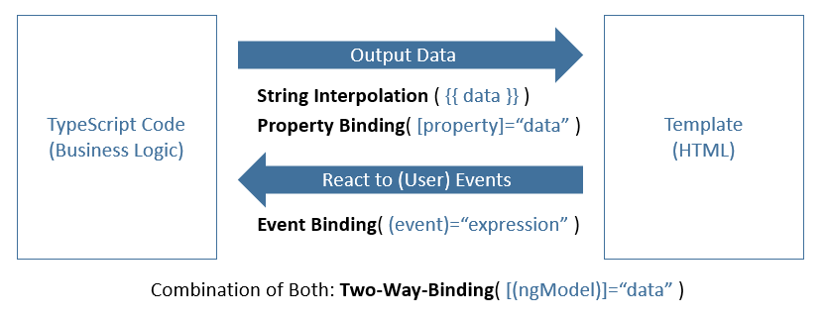
4. Components. The basics
Data binding
Data binding defines the communication between TypeScript logic and the templates.
It is needed to be bidirectional.
Notes:
The communication between TypeScript logic and the templates or what the user see is defined as a data binding. It is needed to be bidirectional. For example, when it might has some result in TS code because it fetched something from the server or finished some calculation and the view must be updated with this information, and when the user interacts with the template by clicking a button and it maybe wants to trigger something in the TS code, allowing to react to events occurred.

Slide 27
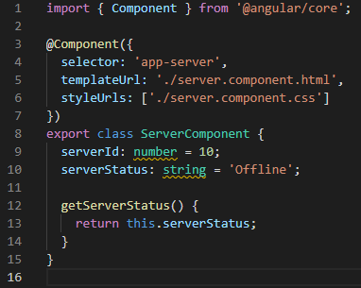
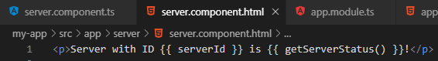
4. Components. The basics
Data binding. String Interpolation
server.component.html
server.component.ts
Notes:
The communication between TypeScript logic and the templates or what the user see is defined as a data binding. It is needed to be bidirectional. For example, when it might has some result in TS code because it fetched something from the server or finished some calculation and the view must be updated with this information, and when the user interacts with the template by clicking a button and it maybe wants to trigger something in the TS code, allowing to react to events occurred.

Slide 28
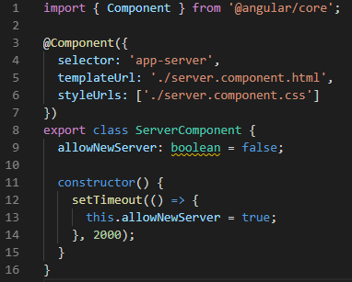
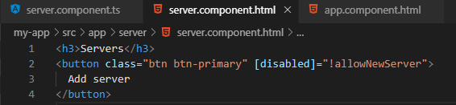
4. Components. The basics
Data binding. Property binding
server.component.html
server.component.ts
Notes:
The communication between TypeScript logic and the templates or what the user see is defined as a data binding. It is needed to be bidirectional. For example, when it might has some result in TS code because it fetched something from the server or finished some calculation and the view must be updated with this information, and when the user interacts with the template by clicking a button and it maybe wants to trigger something in the TS code, allowing to react to events occurred.

Slide 29
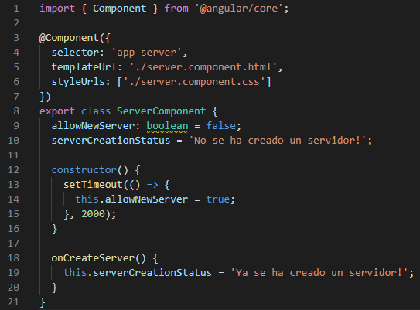
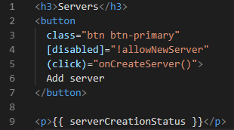
4. Components. The basics
Data binding. Event binding
server.component.html
server.component.ts
Notes:
The communication between TypeScript logic and the templates or what the user see is defined as a data binding. It is needed to be bidirectional. For example, when it might has some result in TS code because it fetched something from the server or finished some calculation and the view must be updated with this information, and when the user interacts with the template by clicking a button and it maybe wants to trigger something in the TS code, allowing to react to events occurred.

Slide 30
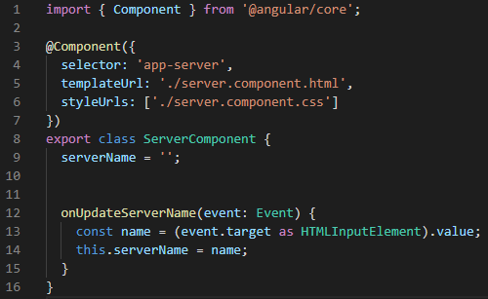
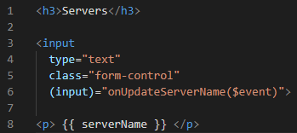
4. Components. The basics
Data binding. Passing data with event binding
server.component.html
i
$event is a variable reserved for event binding to access to the event data
server.component.ts
Notes:
The communication between TypeScript logic and the templates or what the user see is defined as a data binding. It is needed to be bidirectional. For example, when it might has some result in TS code because it fetched something from the server or finished some calculation and the view must be updated with this information, and when the user interacts with the template by clicking a button and it maybe wants to trigger something in the TS code, allowing to react to events occurred.

Slide 31
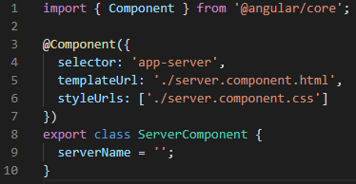
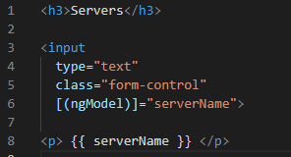
4. Components. The basics
Data binding. Two-way-binding
server.component.html
server.component.ts
Notes:
The communication between TypeScript logic and the templates or what the user see is defined as a data binding. It is needed to be bidirectional. For example, when it might has some result in TS code because it fetched something from the server or finished some calculation and the view must be updated with this information, and when the user interacts with the template by clicking a button and it maybe wants to trigger something in the TS code, allowing to react to events occurred.

Slide 32
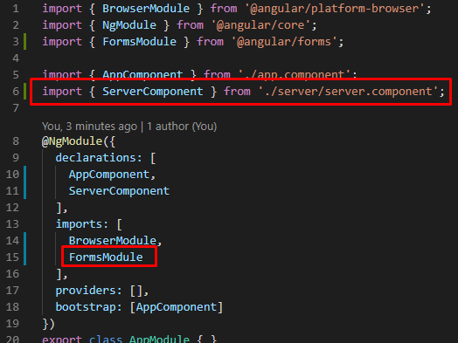
4. Components. The basics
Data binding. Two-way-binding
To use [(ngModel)] is required to import FormsModule in the AppModule.
app.module.ts
Notes:
The communication between TypeScript logic and the templates or what the user see is defined as a data binding. It is needed to be bidirectional. For example, when it might has some result in TS code because it fetched something from the server or finished some calculation and the view must be updated with this information, and when the user interacts with the template by clicking a button and it maybe wants to trigger something in the TS code, allowing to react to events occurred.

Slide 33
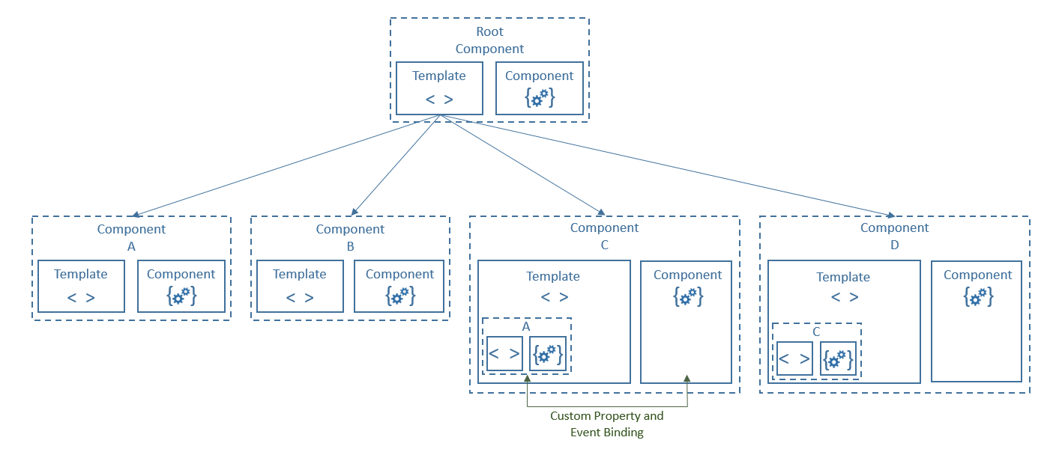
4. Components. The basics
Interaction between components
The direct communication between parent and child components is possible through Custom property and Event binding techniques.
Notes:
Data binding also plays an important role in communication between parent and child components. There are different ways to transfer information dynamically from parent to child component and vice versa thought custom property and event binding.

Slide 34
Index
Angular introduction
Getting started
Modules
Components. The basics
Directives
Models
Pipes
Components. Communication between components
Services
Forms
Observables
Routing and navigation
HTTP Requests
Debugging
Introduction to testing practices

Slide 35
5. Directives
Introduction to directives
A directive is a class that gives instructions to render the templates and transform the DOM.
Is defined with @Directive decorator.
There are two types of directives: structural and attribute.
Structural
Attribute
Modify the DOM layout by adding and removing DOM elements.
They change the structure of the view
Change the appearance or behavior of an element, component, or another directive.
They are used as attributes of elements
NgFor
NgIf
NgSwitch
ngStyle
ngClass,
ngModel

Slide 36
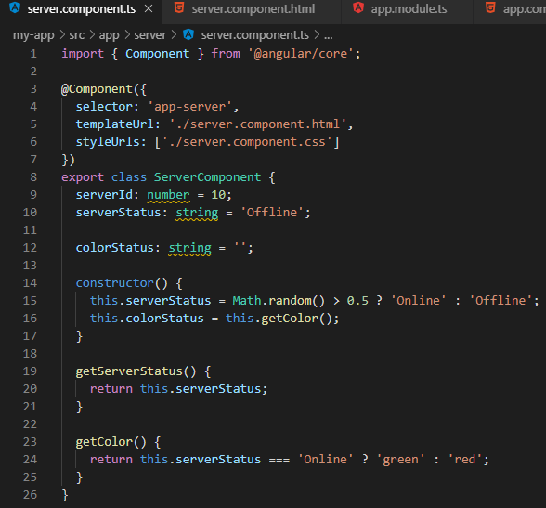
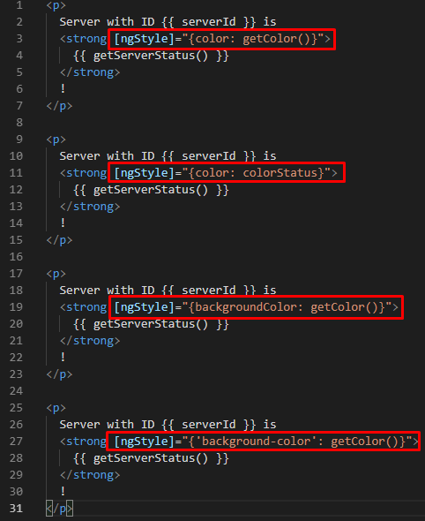
5. Directives
Attribute. ngStyle
This directive, used as attribute, is useful to change the style of an element dynamically.
server.component.ts
server.component.ts

Slide 37
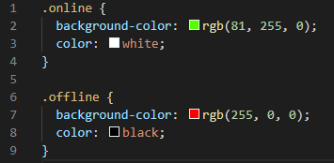
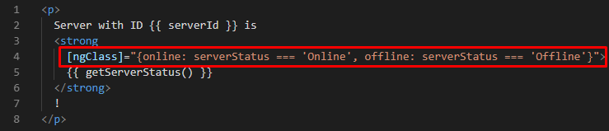
5. Directives
Attribute. ngClass
This directive is useful to create different classes in CSS file and assign them to an element dynamically.
server.component.css
server.component.html
server.component.ts

Slide 38
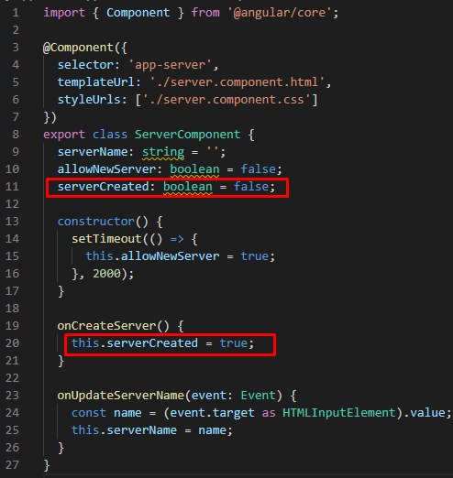
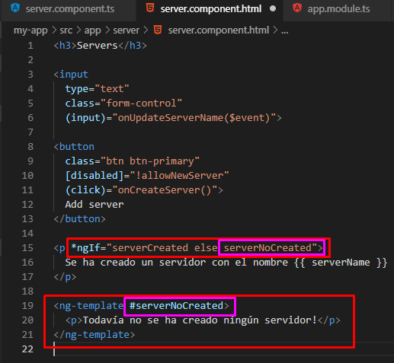
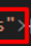
5. Directives
Structural. NgIf
The elements are not rendered in the DOM, then it improves the performance and the page rendering time.
server.component.html
server.component.ts

Slide 39
5. Directives
Structural. NgIf and else with ng-template
The ng-template tag content will replace the element with the NgIf directive when the condition is not met.
server.component.ts
server.component.html

Slide 40
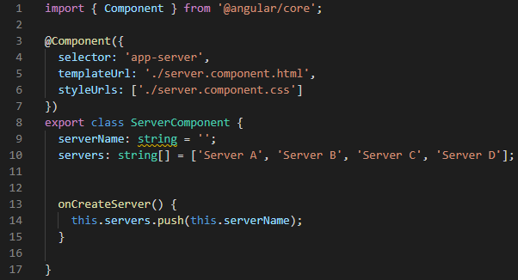
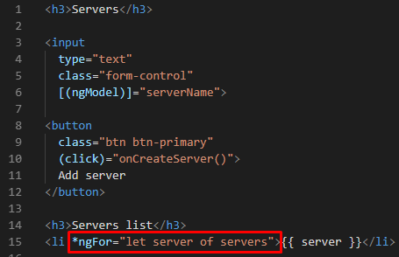
5. Directives
Structural. NgFor
This directive is used to list the elements of an array.
server.component.ts
server.component.html

Slide 41
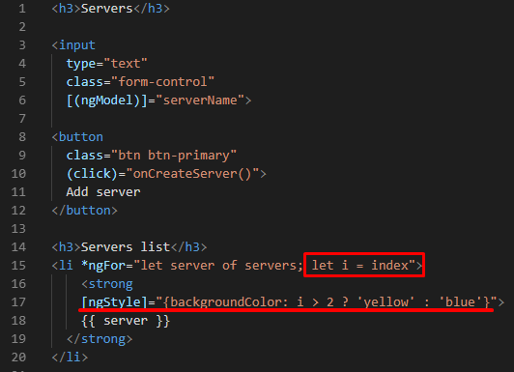
5. Directives
Structural. NgFor. Using index
server.component.ts
server.component.html
i
Angular exposes the following local variables: index, first, last, even, odd.
Notes:
index: current loop iteration for each template context. first: boolean value indicating whether the item is the first one in the iteration. last: boolean value indicating whether the item is the last one in the iteration. even: value indicating whether this item has an even index. odd: boolean value indicating whether this item has an odd index

Slide 42
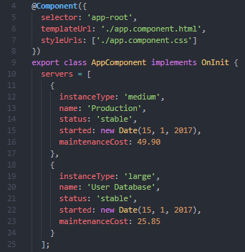
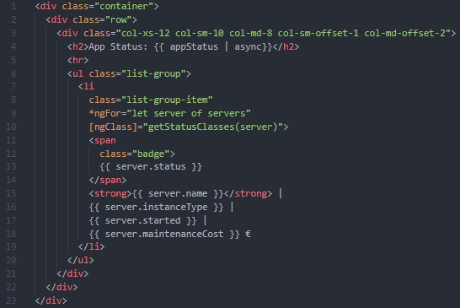
5. Directives
Structural. NgFor. Objects arrays
This directive can also be used to iterate through a list of objects.
server.component.html
server.component.ts

Slide 43
5. Directives
Structural. NgFor. TrackBy mechanism
When passing an array to *ngFor, the directive draws elements to the DOM.
When changing or modifying some element of this array, all these elements are completely redrawn to the DOM from scratch, which is a very expensive and heavy operation.
We can improve the *ngFor performance with the trackBy mechanism by tracking which item has been changed.
i
When use trackBy really make sense?
Iterating over a large array of objects collection
Your business logic might need to modify any of these elements through reordering, modifying a specific item, deleting an item, or adding a new one

Slide 44
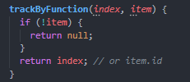
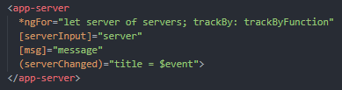
5. Directives
Structural. NgFor. TrackBy mechanism
The trackBy function takes the index and the current item as arguments and needs to return the unique identifier for this item.
When we change the collection, Angular can track which items have been added or removed according to the unique identifier and creates or destroys only the items that changed.
servers.component.ts
servers.component.html

Slide 45
Index
Angular introduction
Getting started
Modules
Components. The basics
Directives
Models
Pipes
Components. Communication between components
Services
Forms
Observables
Routing and navigation
HTTP Requests
Debugging
Introduction to testing practices

Slide 46
6. Models
Introduction to models
A Model is a class or an interface which represents an object defined by a set of custom properties and methods.
This typing technique provides a structured and sturdiness solution.
Models can be used in the entire application.
Interfaces
Classes
Type-checking
Removed during compilation
Type-checking
Instantiation
Provide the implementation of the data model methods.
Greater transpiled bundles
Notes:
Classes vs Interfaces:
https://jameshenry.blog/typescript-classes-vs-interfaces/
https://ultimatecourses.com/blog/classes-vs-interfaces-in-typescript

Slide 47
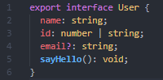
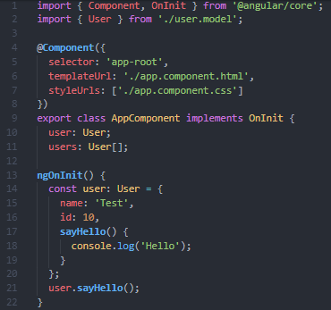
6. Models
Interfaces
If we want to create types for data model e.g. by coming from a remote server, or just for creating new data and save it, it is a good approach to use an interface.
Interfaces are completely removed during compilation and so they will not add any unnecessary bloat to our final JavaScript code.
user.model.ts
app.component.ts

Slide 48
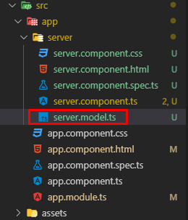
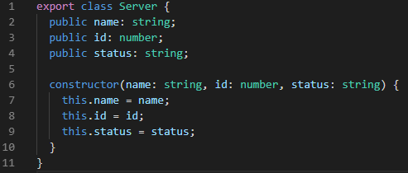
6. Models
Classes
If we want to create more complex data models, e.g. by implementing some of its methods, it is recommended to use classes.
server.model.ts

Slide 49
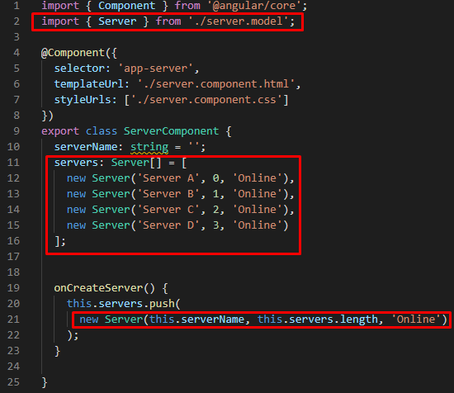
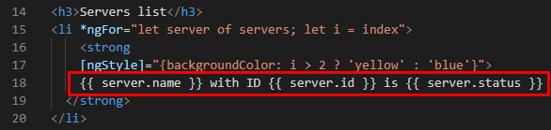
6. Models
Classes
If we want to create more complex data models, e.g. by implementing some of its methods, it is recommended to use classes.
server.component.html
server.component.ts

Slide 50
Index
Angular introduction
Getting started
Modules
Components. The basics
Directives
Models
Pipes
Components. Communication between components
Services
Forms
Observables
Routing and navigation
HTTP Requests
Debugging
Introduction to testing practices

Slide 51
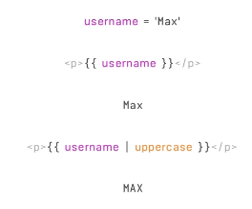
7. Pipes
Introduction to pipes
Pipes are a way to display value transformations that can be declared in the HTML.
It takes a data as an input and transforms it to the desired output.
Angular provide some built-in pipes.
It is possible to create custom pipes through the @Pipe decorator function.
It does not change the value of username and only changes the way it is displayed in the screen.
i
It is possible to use pipes in the business logic (TS) but it is not the most usual case.
Notes:
There are pipes for different types of output and also for synchronous and asynchronous data.

Slide 52
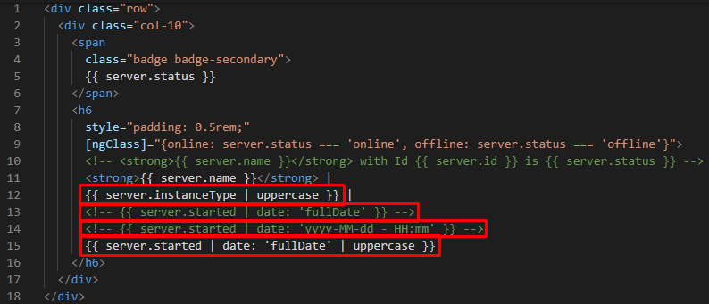
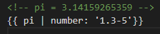
7. Pipes
Built-in pipes examples
Angular provide some useful built-in pipes.
!
When we concatenate multiple pipes, the order is important!
server.component.html

Slide 53
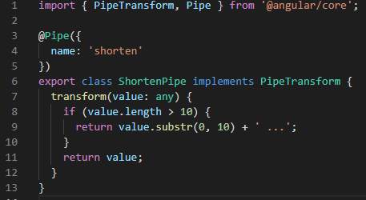

7. Pipes
Custom pipes
The custom pipes must be added in the declarations property of the module where we want to use it, the AppModule in this case.
shorten.pipe.ts
app.module.ts

Slide 54

7. Pipes
Custom pipes
These ones are used in the same way as the built-in ones, now with the name that has been set under the pipe configuration.
server.component.html

Slide 55


7. Pipes
Custom pipes. Parameterizing custom pipes
shorten.pipe.ts
server.component.html
i
It is possible to set a default parameter value by adding it in the transform method in the following way:
transform (value: any, limit: number = default_parameter_value )

Slide 56
Index
Angular introduction
Getting started
Modules
Components. The basics
Directives
Models
Pipes
Components. Communication between components
Services
Forms
Observables
Routing and navigation
HTTP Requests
Debugging
Introduction to testing practices

Slide 57
8. Components. Communication between components
Interaction between components
The direct communication between parent and child components is possible through Custom property and Event binding techniques.
Notes:
Data binding also plays an important role in communication between parent and child components. There are different ways to transfer information dynamically from parent to child component and vice versa thought custom property and event binding.

Slide 58

8. Components. Communication between components
Custom property
Custom Property is used to transmit data from parent component to child.

Slide 59


8. Components. Communication between components
Custom property
Child component
server.component.html
server.component.ts

Slide 60


8. Components. Communication between components
Custom property
Parent component
servers.component.html
servers.component.ts

Slide 61


8. Components. Communication between components
Custom property
Alias, custom property name used in the parent component to distinguish it from the name of the child variable.
servers.component.html (parent)
server.component.ts (child)

Slide 62

8. Components. Communication between components
Event binding
Custom Property is used to transmit data from child component to parent.

Slide 63


8. Components. Communication between components
Event binding
Child component
server.component.html
server.component.ts

Slide 64


8. Components. Communication between components
Event binding
Parent component
servers.component.html
servers.component.ts

Slide 65


8. Components. Communication between components
Injecting content with ng-content (Content Projection)
We can inject external template block to a component through ng-content tag.
app.component.html (parent)
i
There can be multiple ng-content tags: example
servers.component.html (child)

Slide 66


8. Components. Communication between components
NgModel vs local references
Instead of getting a value through Two-way-data binding with NgModel, is useful to get the value only at a point of time we click on a button.
servers.component.html
servers.component.ts

Slide 67


8. Components. Communication between components
Local references
Holds a reference to the whole HTML element with all its properties, not only the value.
Local reference can be placed on any HTML element.
It can be used anywhere in the template but not in the TS.
servers.component.html
servers.component.ts
Notes:
Take into account that not all elements have the same properties.

Slide 68

8. Components. Communication between components
@ViewChild
It is a way to access and manipulate DOM elements, directives and components.
app.component.ts
app.component.html

Slide 69
8. Components. Communication between components
Lifecycle hooks
Angular creates it, renders it, creates and renders its children, checks it when its data-bound properties change, and destroys it before removing it from the DOM.
Angular offers lifecycle hooks that provide visibility into these key life moments and the ability to act when they occur.
constructor
ngOnChanges
ngOnInit
ngDoCheck
ngAfterContentInit
ngAfterContentChecked
ngAfterViewInit
ngAfterViewChecked
ngOnDestroy
Notes:
ngOnChanges: called after a bound input Property changes.
ngOnInit: called once the component is initialized.
ngDoCheck: called during every change detection run.
ngAfterContentInit: called after content (ng-content) has been projected into a view.
ngAfterContentChecked: called every time the projected content has been checked.
ngAfterViewInit: called after the component’s view (and child views) has been initialized.
ngAfterViewChecked: called every time the view (and child views) have been checked.
ngOnDestroy: called once the component is about to be destroyed.
Seeing Lifecycle Hooks in Action: https://www.udemy.com/course/the-complete-guide-to-angular-2/learn/lecture/6656106#overview

Slide 70
Index
Angular introduction
Getting started
Modules
Components. The basics
Directives
Models
Pipes
Components. Communication between components
Services
Forms
Observables
Routing and navigation
HTTP Requests
Debugging
Introduction to testing practices

Slide 71
9. Services
Introduction to services
A service is a class that fetches or save data.
Can be invoked from any component or service.
This helps in dividing the web application into small, different logical units which can be reused, doing this through dependency injection.
We must indicate with the @Injectable decorator a service where we want to use another service.

Slide 72
9. Services
Dependency injection
Dependency injection (DI), is an application design pattern.
Angular has its own DI framework, which is typically used to increase application efficiency and modularity.
Dependencies are services or objects that a class needs to perform its function and are provided from external sources rather than be created by the class.
In Angular, the DI framework provides declared dependencies to a class when that class is instantiated.

Slide 73

9. Services
Using services
The most typical use cases to apply services in are duplication of code and data storage.

Slide 74

9. Services
Using services
The most typical use cases to apply services in are duplication of code and data storage.

Slide 75


9. Services
Using services. Duplication of code
We can avoid the duplication of code in different components by externalizing methods or blocks of TS code setting them in a common service.
servers.service.ts (service)
servers.component.ts

Slide 76


9. Services
Using services. Manage data
Parent component
servers.service.ts (service)
servers.component.ts (parent)

Slide 77

9. Services
Using services. Manage data
Child component
servers.service.ts (service)
server.component.ts (child)

Slide 78
9. Services
Using services. Manage data
Child component
!
By declaring the service in the child component as a provider we are creating another instance of the service, the parent one is overwritten!
✘
It is not always a wrong approach but in this case, it is not how we must use it
server.component.ts (child)

Slide 79
9. Services
Using services. Hierarchical injector
Angular dependency injector actually is a hierarchical injector
AppModule
Same Instance of Service is available Application-wide
AppComponent
Same Instance of Service is available for all Components (but not for other Services)
Any other Component
Same Instance of Service is available for the Component and all its child components

Slide 80


9. Services
Using services. Manage data
In our example, we remove the service from the providers property both for parent and child components.
servers.component.ts (parent)
server.component.ts (child)

Slide 81

9. Services
Using services. Manage data
Following with our example, we can define the service in the AppComponent.
i
Note that, in this case, we could leave the service set in the parent component (servers) and its child component (server) would use the same instance due to the hierarchical injector dependency.
app.component.ts

Slide 82

9. Services
Using services. Manage data
Or in the AppModule providers, where services are usually defined.
app.module.ts

Slide 83

9. Services
Create a service with CLI
Use the command:
$ ng generate service service_name
The TS service file is created automatically with the @Injectable decorator.
The new service is not declared in the module providers automatically, nevertheless, it adds an equivalent declaration in the service file:
Angular CLI commands
servers.service.ts

Slide 84


9. Services
Injecting services into services
The @Injectable decorator must be added in the service where we want to use the other service, that is, in the receiver.
logging.service.ts (the service we want to use)
servers.service.ts (the injectable service)

Slide 85
Index
Angular introduction
Getting started
Modules
Components. The basics
Directives
Models
Pipes
Components. Communication between components
Services
Forms
Observables
Routing and navigation
HTTP Requests
Debugging
Introduction to testing practices

Slide 86
10. Forms
Introduction to forms
Angular offers two approaches when it comes to handling forms:
Template-Driven
Reactive
- We set up the form in the template (HTML).
- Angular infers Form Object from the DOM.
Form is created programmatically (TS) and synchronized with the DOM.

Slide 87

10. Forms
Creating reactive forms. Basic template
The form tag, the controls and the submit button.
create-server.component.html

Slide 88


10. Forms
Creating reactive forms. Defining the form programmatically
Add the ReactiveFormsModule in the module we will set the form.
Create the form as FormGroup and every of its controls as FormControl.
app.module.ts
create-server.component.ts

Slide 89

10. Forms
Creating reactive forms. Synchronizing form with the template
Connect manually the form and its controls programmatically created with the template.
create-server.component.html

Slide 90


10. Forms
Creating reactive forms. Submitting the form
Set up the submit function in the form tag, not in the button.
i
Note that, the type attribute of the button is “submit”, so we can add the submit function in the form tag.
create-server.component.ts
create-server.component.html

Slide 91

10. Forms
Creating reactive forms. Form validation
Adding validations to controls, the form validation is automatically set.
Each control can have multiple validations which can be synchronous and asynchronous .
Angular offers useful built-in validators.
Custom validations can be created.
create-server.component.ts

Slide 92

10. Forms
Creating reactive forms. Form validation. Built-in validators. Patterns and regular expressions
We can use RegExp as validators.
create-server.component.ts

Slide 93

10. Forms
Creating reactive forms. Form validation. Built-in validators. MaxLength
create-server.component.ts

Slide 94

10. Forms
Creating reactive forms. Accessing to the form controls properties
We can save the form controls under a variable with get and use it both from TS and HTML.
create-server.component.ts

Slide 95


10. Forms
Creating reactive forms. Accessing to the form controls properties
We can access to all form and controls properties from both the TS and the HTML.
create-server.component.ts
create-server.component.html

Slide 96


10. Forms
Creating reactive forms. Form validation. Displaying error messages
We can use the form or controls properties to display error messages in order to let the user know if a form field or the entire form is valid or not.
create-server.component.html (form error message)
create-server.component.html (form controls error messages)

Slide 97


10. Forms
Creating reactive forms. Form validation. Styling error messages
We can give to the error messages some styles and we can access to the form controls classes Angular adds automatically.
Elements tab from Chrome DevTools (Form control classes added by Angular by default)
create-server.component.css

Slide 98

10. Forms
Creating reactive forms. Form validation. Check the form validation when submit
We can check the validity of the form when the user submits it and take actions from there.
create-server.component.ts

Slide 99



10. Forms
Creating reactive forms. Form validation. Custom validators
create-server.component.ts (forbidden names declaration)
create-server.component.ts (using custom validator in the form control)
create-server.component.ts (custom validator function)

Slide 100

10. Forms
Creating reactive forms. Form validation. Custom validators
We can access to the triggered error of the custom validator from the template in the same way as the other validation errors.
create-server.component.html
Notes:
Video Async Validator: https://www.udemy.com/the-complete-guide-to-angular-2/learn/lecture/6656522#overview

Slide 101

10. Forms
Creating reactive forms. Other interesting reactive forms features. valueChanges and statusChanges
It detects changes in the form value and status by subscribing to the them.
create-server.component.ts

Slide 102


10. Forms
Creating reactive forms. Other interesting reactive forms features. Reset, setValue, patchValue …
create-server.component.ts (reset)
create-server.component.ts (setValue and patchValue)

Slide 103
Index
Angular introduction
Getting started
Modules
Components. The basics
Directives
Models
Pipes
Components. Communication between components
Services
Forms
Observables
Routing and navigation
HTTP Requests
Debugging
Introduction to testing practices

Slide 104

11. Observables
Introduction to observables
An observable can be thought of as a data source.
We can receive the data automatically when it is updated in the data source.
With Observables approach, we can save costs in terms of performance.
Angular uses Observables internally being able to subscribe to routes, HTTP requests, etc.
We can create our own (pure) Observables through the third-party package RxJS.
Three main actors:
Observable
Observer
Subject
Notes:
ReactiveX is a library for composing asynchronous and event-based programs by using observable sequences.
It extends the observer pattern to support sequences of data and/or events and adds operators that allow you to compose sequences together declaratively while abstracting away concerns about things like low-level threading, synchronization, thread-safety, concurrent data structures, and non-blocking I/O.
RxJS is a library for reactive programming using Observables, to make it easier to compose asynchronous or callback-based code. It is the JS implementation of ReactiveX.
Observables are a feature added by other third-party package (RxJS), not by Angular but heavily used by Angular, which allows to easily work with asynchronous tasks. So an Observable is an easy way to subscribe to some event which might happen in the future, to then execute some code when it happens without having to wait for it.

Slide 105

11. Observables
Introduction to observables

Slide 106

11. Observables
Introduction to observables

Slide 107



11. Observables
Code workflow
1. It declares the Subject
2. Component sends data through the service
data.service.ts
emitter.component.ts
3. Subject sends the nofication (with the data)
4. Orserver receives the data
receiver.component.ts
Notes:
Differences between Subject and BehaviourSubject: https://stackoverflow.com/questions/39494058/behaviorsubject-vs-observable

Slide 108
Index
Angular introduction
Getting started
Modules
Components. The basics
Directives
Models
Pipes
Components. Communication between components
Services
Forms
Observables
Routing and navigation
HTTP Requests
Debugging
Introduction to testing practices

Slide 109
12. Routing and navigation
Introduction to routing and navigation
Angular has its own router which allows to change the URL in the URL bar and it only uses one page, one index.html.
It exchange major parts or a lot of parts of that page.
To the user, it looks like a new page is rendered but, behind the scenes, it changes a lot of parts of the DOM.
We must define the routes and the Angular router, which it needs to know which routes the app has.

Slide 110


12. Routing and navigation
Defining routes
The routes are defined as an NgModule and it is declared as an import of the main module.
app-routing.module.ts
app.module.ts

Slide 111

12. Routing and navigation
Injecting the routes content
Each route has its own path and it is associated to a component o module. The way which Angular know where has to inject that content is through the router-outlet tag.
app.component.html

Slide 112


12. Routing and navigation
Navigating from the template
We can configure a navigation link in the HTML with the routerLink attribute.
app.component.html
app.component.html
✘
The href attribute forces the reloading of the page.

Slide 113

12. Routing and navigation
Styling active router links
We can assign a class to the router link with the routerLinkActive attribute.
app.component.html

Slide 114



12. Routing and navigation
Navigating programmatically
We can trigger the navigation from the TS.
home.component.html
home.component.ts (navigation to the defined route)
servers.component.ts (navigation to the defined route, from the relative path)

Slide 115


12. Routing and navigation
Passing parameters to routes (I)
If we only access to this route externally (from another route or component or by URL bar).
app.module.ts
home.component.html
1. Define the route
2. External component where we access from

Slide 116


12. Routing and navigation
Receiving parameters from routes (I)
If we only access to this route externally (from another route or component or by URL bar).
user.component.html
4. Component template where we use the parameters
3. Component where we get the parameters from the route
user.component.ts

Slide 117

12. Routing and navigation
Passing parameters to routes (II)
If we access to the route from the same component (e.g. through a link), we must subscribe to the route in order to detect the changes on it.
app.module.ts
user.component.html
1. Define the route
2. Component template where we use the parameters we get from route and link to navigate to the same route but with different parameters

Slide 118

12. Routing and navigation
Receiving parameters from routes (II)
If we access to the route from the same component (e.g. through a link), we must subscribe to the route in order to detect the changes on it.
user.component.html
4. Component template where we use the parameters
3. Component where we get the parameters from the route and we subscribe to the changes on it.
user.component.ts

Slide 119
12. Routing and navigation
Receiving parameters from routes (II)
If we access to the route from the same component (e.g. through a link), we must subscribe to the route in order to detect the changes on it.
i
It is a good practice to save this kind of subscriptions in a variable when creating them in order to unsubscribe from them when the component is destroyed by using the ngOnDestroy component lifecycle method.
user.component.ts

Slide 120


12. Routing and navigation
Query parameters
Allow for passing optional parameters across any route in the application.
Are different from regular route parameters (e.g.: /product/:id).
home.component.ts (programmatically)
servers.component.html (from the template)

Slide 121
12. Routing and navigation
Fragments
Refer to certain elements on the page identified with an id attribute.
By adding an anchor element we can jump to a certain point on the page.
home.component.ts (programmatically)
servers.component.html (from the template)
Notes:
Example of fragment: https://angular.io/guide/architecture-components#templates-and-views

Slide 122

12. Routing and navigation
Receiving query parameters and fragments
If we use the snapshot feature in ngOnInit, it will only get the query parameters and fragments in the initialization of the component and it will not be able to react to changes of these values. We should subscribe to the changes like with the Parameters.
edit-server.component.ts

Slide 123



12. Routing and navigation
Child routes
app-routing.module.ts
It defines the child routes under the children property of the parent route
servers.component.html (parent)
Injects the children in the parent template by adding the router-outlet tag
server.component.ts (child)
Child component gets the parameter id from the route

Slide 124





12. Routing and navigation
Other configuration options
Angular route configuration options
pathMatch
canActivate
wildcard
resolve
data
app-routing.module.ts

Slide 125

12. Routing and navigation
Lazy loading
It is a design pattern that consists of delaying the loading or initialization of an object until it is needed.
Angular allows to load the JavaScript components asynchronously when a specific route is activated.
In this way, lazy loading speeds up our application load time by splitting it into multiple smaller bundles and loading them on demand.
The lazy loading feature modules are set up through the loadChildren route property.
Notes:
Lazy Loading Feature Modules: https://angular.io/guide/lazy-loading-ngmodules#lazy-loading-feature-modules

Slide 126
Index
Angular introduction
Getting started
Modules
Components. The basics
Directives
Models
Pipes
Components. Communication between components
Services
Forms
Observables
Routing and navigation
HTTP Requests
Debugging
Introduction to testing practices

Slide 127

13. HTTP Requests
Communication with Backend
An Angular app must be able to communicate to some server to store data, to fetch data from there …
It is not connected to a database directly, we must not enter the database credentials into the Angular app for security reasons.
When we visit the Server (API) URL, we are getting back data, mostly in the JSON format.
Notes:
It is not connected to a database directly, we must not enter the database credentials into the Angular app. This would be highly insecure because anyone can read the code by inspecting it since it is a Frontend JavaScript.

Slide 128
13. HTTP Requests
Anatomy of a HTTP Request
Http verb
POST, GET, PUT, DELETE, …
URL (API Endpoint)
/posts/1
Headers (Metadata)
{ “Content-Type”: “application/json” }
Body
{ title: “New Post” }
POST, PUT, PATCH
Notes:
It is not connected to a database directly, we must not enter the database credentials into the Angular app. This would be highly insecure because anyone can read the code by inspecting it since it is a Frontend JavaScript.

Slide 129
13. HTTP Requests
json-server
json-server allow us get a full fake REST API in a simple way.
Run command:
$ npm install –g json-server
Create a new folder (separated from the Angular project)
Create a file db.json in that folder.
Run command:
$ json-server db.json
Open ‘localhost:3000’
Notes:
It is not connected to a database directly, we must not enter the database credentials into the Angular app. This would be highly insecure because anyone can read the code by inspecting it since it is a Frontend JavaScript.

Slide 130

13. HTTP Requests
Importing HttpClientModule into AppModule
HttpClient performs HTTP requests.
app.module.ts
Notes:
It is not connected to a database directly, we must not enter the database credentials into the Angular app. This would be highly insecure because anyone can read the code by inspecting it since it is a Frontend JavaScript.

Slide 131

13. HTTP Requests
POST request
We always must to subscribe to the HTTP request (note that post( ) returns an Observable.
POST request needs a request body, the data we want to store.
We normally send JSON data when interacting with an API REST and Angular takes the JavaScript object server and converts it to JSON automatically.
body
URL (API Endpoint)
servers.service.ts
Notes:
It is not connected to a database directly, we must not enter the database credentials into the Angular app. This would be highly insecure because anyone can read the code by inspecting it since it is a Frontend JavaScript.

Slide 132



13. HTTP Requests
Checking the HTTP Requests in the browser DevTools
First OPTIONS request checks whether the POST is allowed to be sent, if that gets a success response, it will send the actual request
i
Default headers added by Angular
JSON data sent
Notes:
It is not connected to a database directly, we must not enter the database credentials into the Angular app. This would be highly insecure because anyone can read the code by inspecting it since it is a Frontend JavaScript.

Slide 133


13. HTTP Requests
GET request
Once again, we must subscribe to the HTTP request.
URL (API Endpoint)
servers.service.ts (service)
servers.component.ts (component)
Notes:
It is not connected to a database directly, we must not enter the database credentials into the Angular app. This would be highly insecure because anyone can read the code by inspecting it since it is a Frontend JavaScript.

Slide 134


13. HTTP Requests
Getting data when it has been modified
It is possible that other components are consuming the data we have modified so, we could inform them using an observable to they fetch the new data.
1. It declares the Subject
2. The consumer component subscribes to the observable
4. It gets the data again once receives the notification
3. Once it gets the response, it emits a notification
servers.component.ts (component)
servers.service.ts (service)
Notes:
It is not connected to a database directly, we must not enter the database credentials into the Angular app. This would be highly insecure because anyone can read the code by inspecting it since it is a Frontend JavaScript.

Slide 135


13. HTTP Requests
DELETE request
Once again, we must subscribe to the HTTP request.
URL (API Endpoint)
servers.service.ts (service)
We send the notification that the data has been modified
servers.component.ts (component)
Notes:
It is not connected to a database directly, we must not enter the database credentials into the Angular app. This would be highly insecure because anyone can read the code by inspecting it since it is a Frontend JavaScript.

Slide 136
Index
Angular introduction
Getting started
Modules
Components. The basics
Directives
Models
Pipes
Components. Communication between components
Services
Forms
Observables
Routing and navigation
HTTP Requests
Debugging
Introduction to testing practices

Slide 137

14. Debugging
Introduction to debugging
Bugs are unavoidable in any non-trivial application.
Knowing how to debug an application is a key skill for developers, and speeds up the process of eliminating bugs and delivering software.
It is important to harness tools and techniques to fix the bugs.
Angular uses some popular code debugging techniques and also has some unique tools and techniques to debugging its applications.
Notes:
Debugging guide: https://medium.com/@vamsivempati/a-guide-to-debugging-angular-applications-5a36bd88b4cf
Advanced tips: https://blog.angularindepth.com/everything-you-need-to-know-about-debugging-angular-applications-d308ed8a51b4

Slide 138
14. Debugging
Source maps
It is not easy to debug the transpiled JavaScript bundles.
A source map maps the transformed source to the original source, enabling the browser to reconstruct the original one.
They help us display our original TypeScript source code under webpack:// in the development tools, where we can place the breakpoints we need to debug.
The source maps are only available in development environments, they are stripped out for production.
How to enable them in production without revealing the original code?
Notes:
Source maps: https://blog.angularindepth.com/debug-angular-apps-in-production-without-revealing-source-maps-ab4a235edd85

Slide 139


14. Debugging
Source maps
http://localhost:4200/main.js
webpack:///./src/app/app.component.ts

Slide 140

14. Debugging
Debugger statement
debugger; statement, like console objects, can be used in Angular applications.
Having a debugger statement when the Chrome DevTools is enabled, causes the application to break at a point where we placed it.
app.component.ts

Slide 141

14. Debugging
Debugger statement
Chrome DevTools

Slide 142

14. Debugging
Augury
Augury is a Chrome extension that provides a visual representation of the whole Angular app.
It allows analyze components on a page, their states, dependencies, router information, whether change detection is used for the component.
It shows the visual hierarchy of the selected component and the dependency injections for it.
Router Tree tab displays all the defined routes that are currently loaded in the application. If a component is lazy loaded, it is indicated by [Lazy] next to the component.
Augury documentation
Notes:
Augury makes it is easy to inspect the state of a component from its Component Tree tab under Properties tab
Using View Source link, you can navigate to the source code for the component.
Injector Graph tab under Component Tree tab shows the visual hierarchy of the selected component and the dependency injections for it.
Router Tree tab shows all the defined routes that are currently loaded in the application. If a component is lazy loaded, it is indicated by [Lazy] next to the component. This information can be used to detect which routes are not lazy loaded and decide whether or not to lazy load them to improve the performance of the application.

Slide 143
14. Debugging
Network throttling
There are issues which could be caused due to slow networks, especially if there are async operations happening in the application.
Sometimes the end users are on slow networks, and if development and testing is done on faster networks some bugs are hard to find.
DevTools allows to add a custom speed for the network with low kb/s.

Slide 144

14. Debugging
Network throttling
Demo video

Slide 145

14. Debugging
Introduction to debugging
Debug properly using suitable debugging techniques
console.log( )

Slide 146
Index
Angular introduction
Getting started
Modules
Components. The basics
Directives
Models
Pipes
Components. Communication between components
Services
Forms
Observables
Routing and navigation
HTTP Requests
Debugging
Introduction to testing practices

Slide 147





15. Introduction to testing practices
Introduction to testing
Angular projects are created with the test tools integrated by default, allowing to write and execute tests from the beginning without having to install and configure them.
Testing frameworks
Test runners
Types of testing
Unit testing
Functional (or E2E) testing
Written from the programmer's perspective.
Ensure that a particular method (or a unit) of a class performs a set of specific tasks.
Written from the user’s perspective.
Ensures that the system is functioning as users are expecting it to.
Notes:
Angular Testing offical documentation: https://angular.io/guide/testing
Jasmine: Jasmine is an open source behavior-driven development (BDD) framework for testing JavaScript code. It does not depend on any other JavaScript frameworks. It does not require a DOM. And it has a clean, obvious syntax so that you can easily write tests.
Jasmine, and BDD in general, attempts to describe tests in a human readable format so that non-technical people can understand what is being tested.
Karma: Karma is an open source test runner which lets us spawn browsers and run jasmine tests inside of them all from the command line. The results of the tests are also displayed on the command line.
It’s not necessary to know the internals of how Karma works. When using the Angular CLI it handles the configuration for us and for the rest of this section we are going to run the tests using only Jasmine.
Protractor: Protractor is an end-to-end test framework for Angular and AngularJS applications. Protractor runs tests against your application running in a real browser, interacting with it as a user would.

Slide 148
15. Introduction to testing practices
Unit testing
Unit testing is a software development process in which the smallest testable parts of an application, called units, are individually and independently examined for proper operation.
Can be done manually but it is often automated.
Features:
Analyzes the code behavior (expected and unexpected changes).
It behaves as a safeguard against breaking changes. One of the best ways to keep your project bug free is through a test suite.
Makes developers feel guilty free on their code changes.
It also reveals the design mistakes.
Notes:
Unit testing post: https://medium.com/@manivel45/angular-7-unit-testing-code-coverage-5c7a238315b6

Slide 149





15. Introduction to testing practices
Unit testing
Testing framework
written in
Unit Tests
executed by
Test runners
executed in
Browsers

Slide 150

15. Introduction to testing practices
Unit testing. How it works
The beforeEach is the first executed block. There we configure the testing environment module.
Spec files are created by default with CLI
Each it block represents a test and is executed totally independent from the others.
i
describe, beforeEach, it, expect, toBeTruthy, toEqual and toContain are Jasmine methods
app.component.spec.ts

Slide 151


15. Introduction to testing practices
Unit testing. Running tests (with CLI)
Run command:
$ ng test
It will display the results of the test:
It also opens up Chrome window to view the success and failed test cases.

Slide 152
15. Introduction to testing practices
Unit testing. Angular testing utilities
TestBed
configureTestingModule( )
createComponent( )
ComponentFixture
nativeElement
DebugElement
detectChanges( )
Angular testing official documentation
Jasmine JS – Testing Cheat Sheet

Slide 153


15. Introduction to testing practices
Unit testing. Testing a single component
Test module declaration
With fixture, we create the UserComponent in the testing environment
user.component.spec.ts
We create a component instance through debugElement, which is the element exposed for testing purposes
i
It is not needed to add the new user component tag in the app.component.html because we don’t want to view the app in the browser but just test it.

Slide 154


15. Introduction to testing practices
Unit testing. Testing dependencies: components and services
It gets an instance of the service
We need to run change detection to update the component properties because it is not the same state as at the begginning (undefined vs after injection)
user.component.spec.ts
It happens automatically in the app running in the browser, but not here.
!
It checks if the user property of the service and the one of the component match

Slide 155



15. Introduction to testing practices
Unit testing. Testing dependencies: components and services
We set the component property isLoggedIn to force the template to display what we are checking, the user name
We access to the compiled template through debugElement.nativeElement
user.component.html
user.component.spec.ts
i
Note that now we don’t need the service instance because we assume the component properties are updated with the detectChanges( ) and we don’t compare the service value.

Slide 156



15. Introduction to testing practices
Unit testing. Testing async tasks
user.component.spec.ts
data.service.ts

Slide 157


15. Introduction to testing practices
Unit testing. Isolated test: testing a basic pipe
Isolated units does not depend on any other piece of the application and can be tested totally independent of Angular
Pipes have the transform function where we pass a value in and we get an output one.
There might be other similar tasks in the app where it happens the same (e.g. a servie method which only transforms some data).
We don’t need Angular testing utilities, either beforeEach set up
We create a new Pipe and define an evaluation of its transform method
reverse.pipe.spec.ts
reverse.pipe.ts

Slide 158
Resources summary
Resources and references
Angular official documentation
Angular CodeCraft course
MDN: JavaScript references
Can I use
Stack Overflow
Examples of apps made with Angular
How to upgrade the version from an Angular app
Angular Essentials extensión for VSCode
Best Visual Studio Code extensions
Angular workspace structure
npm scripts (package.json)
package.json (spanish)
Bootstrap
Angular Material
PrimeNG
Font Awesome
Angular lifecycle hooks
Models: Classes vs Interfaces (I)
Models: Classes vs Interfaces (II)
Angular built-in pipes.

Slide 159
Resources summary
Resources and references
Angular route configuration options
Lazy loading feature modules
RxJS documentation
Differences between Subject and BehaviourSubject
JSON Server documentation
Angular debugging guide
Advanced tips of debugging
Source maps
Angular Augury documentation
Angular Testing oficial documentation
Unit testing post
Testing HTTP Requests

Slide 160
Thank you for your attention!
Marc Pons Serrano
Front End Digital Expert

